Slide 1
Welsh Learning Platform
Graphic user interface
Author: | fec11
Date: | 10/03/2020
Version: | 3.0
Status: | Release

Slide 2
Ideal users
John is an English student who wishes to learn Welsh
He is not studying the language professionally
He is using this platform in order to memorize all the Welsh words.
LEARNING PLATFORM
Jennifer works in a Welsh company and is taking Welsh courses
She already knows some of the language, but she wants to practice more
PRACTICING PLATFORM
Ffion is Welsh student who is proficient in Welsh, but not completely
She still needs to look up in the dictionary sometimes
DICTIONARY

Slide 3
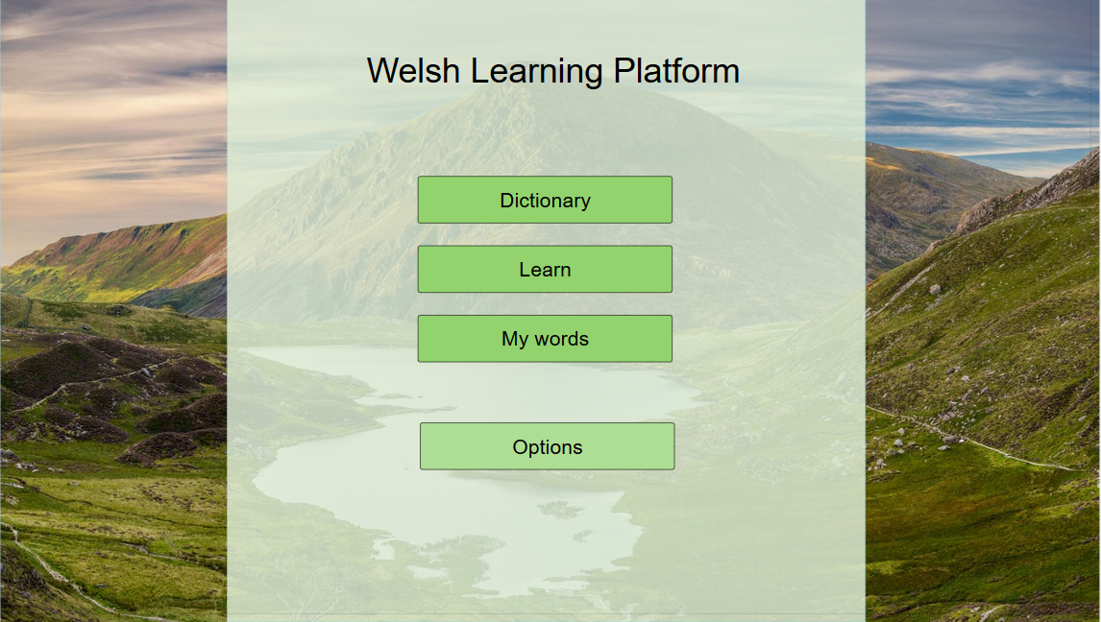
x
Dictionary
Learn New Words
My List of Words

Slide 4
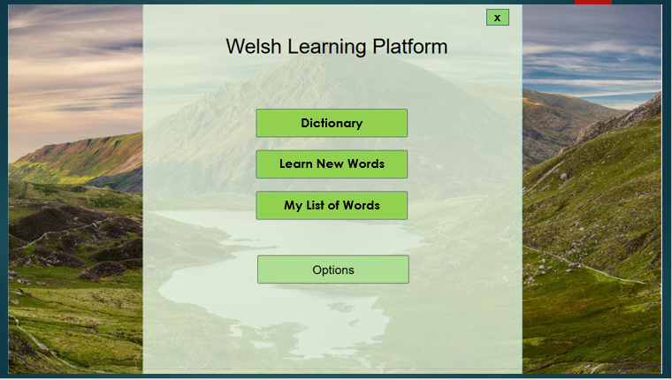
Main Menu
5 simple buttons
Dictionary
Learn new words
My list of words
Options
Close program
x
The “practice words” functionality can be accessed inside “my list of words”, because the user practices only on words he already saw at least one time and saved.

Slide 5
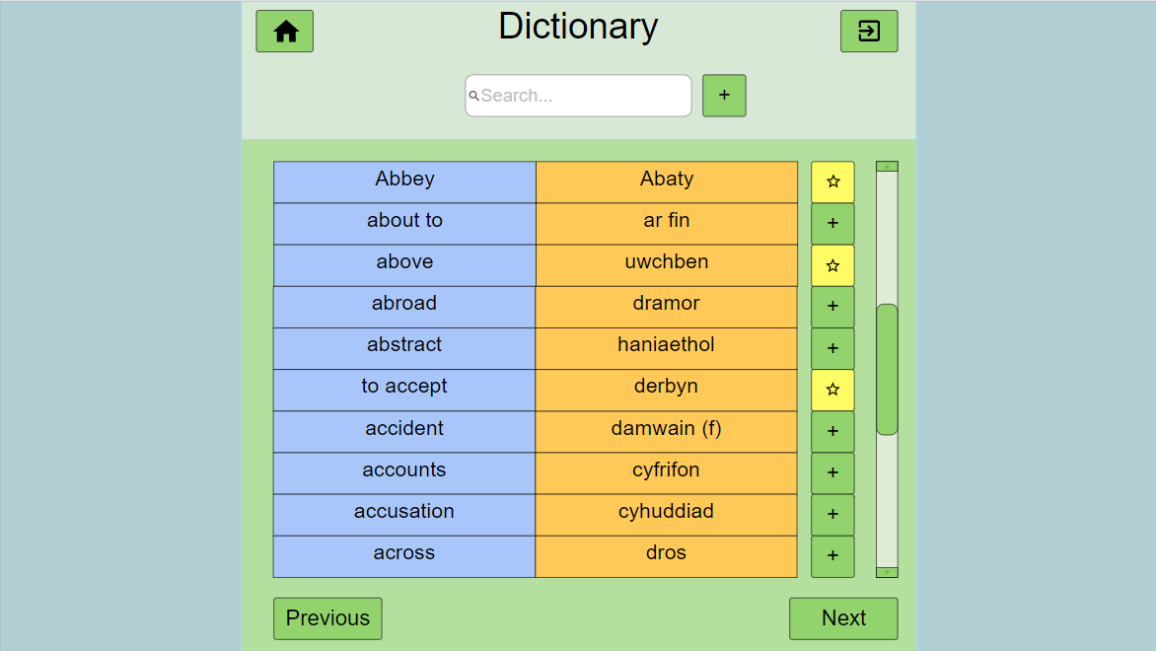
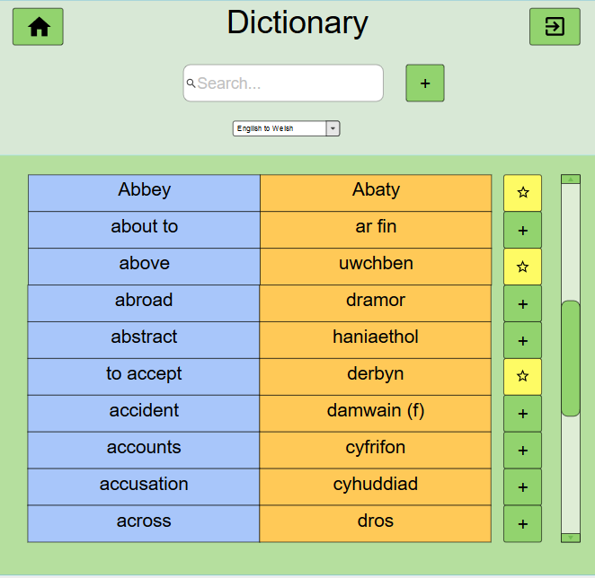
Dictionary
Add new word
In dictionary if
Doesn’t exist yet
Search for words
Change language order
Insert word
In “words to learn”

Slide 6
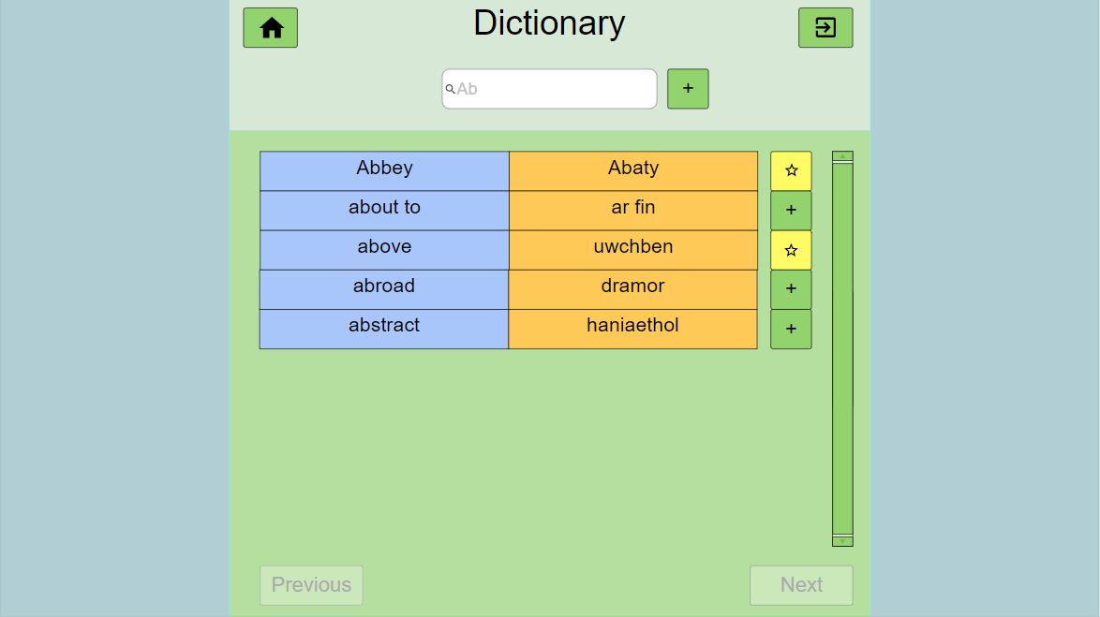
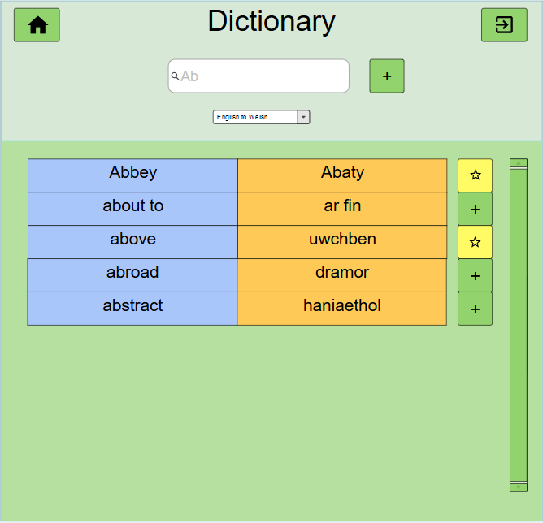
Dictionary
Example: searching a word that begins with “ab”

Slide 7
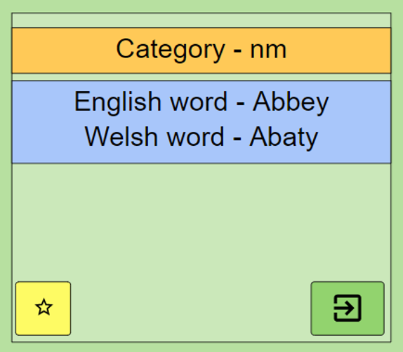
Dictionary
Click on a word to show properties
Confirm remove word
Do you want to remove this word from dictionary?
No
Yes
Remove

Slide 8
Dictionary
Add new word pop-up box
Add new word
English
Welsh
cancel
Add word
Simply write the English word and the welsh
Word and click on the “Add word” button:
The word will be now in the dictionary.

Slide 9
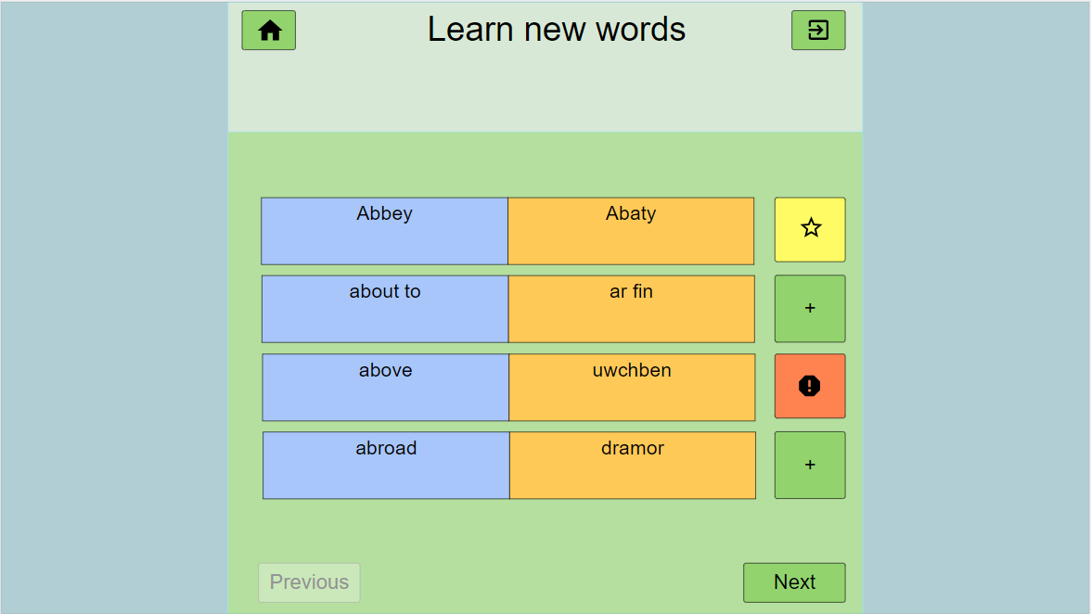
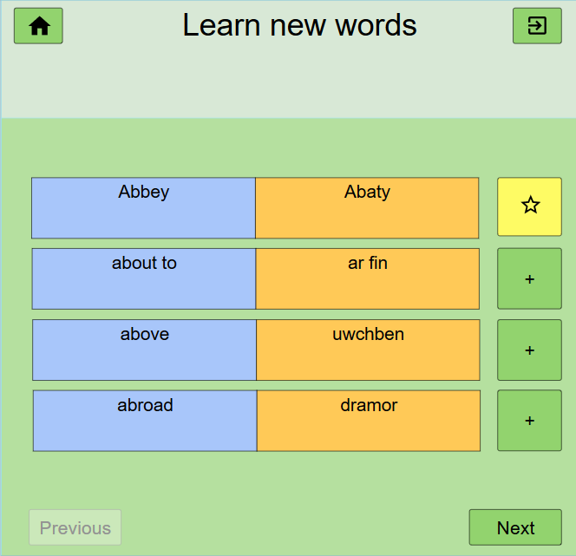
Learn
This function will show new words from the dictionary and allow the user to
memorize them in small groups of words. The words the user wants to learn are
saved in the “my words”, so he can practice later on.

Slide 10
Learn
Home button
Exit button
Random (or ordered) list of words
4 each screen in this layout
Buttons to save a word in list
Next and previous group of words

Slide 11
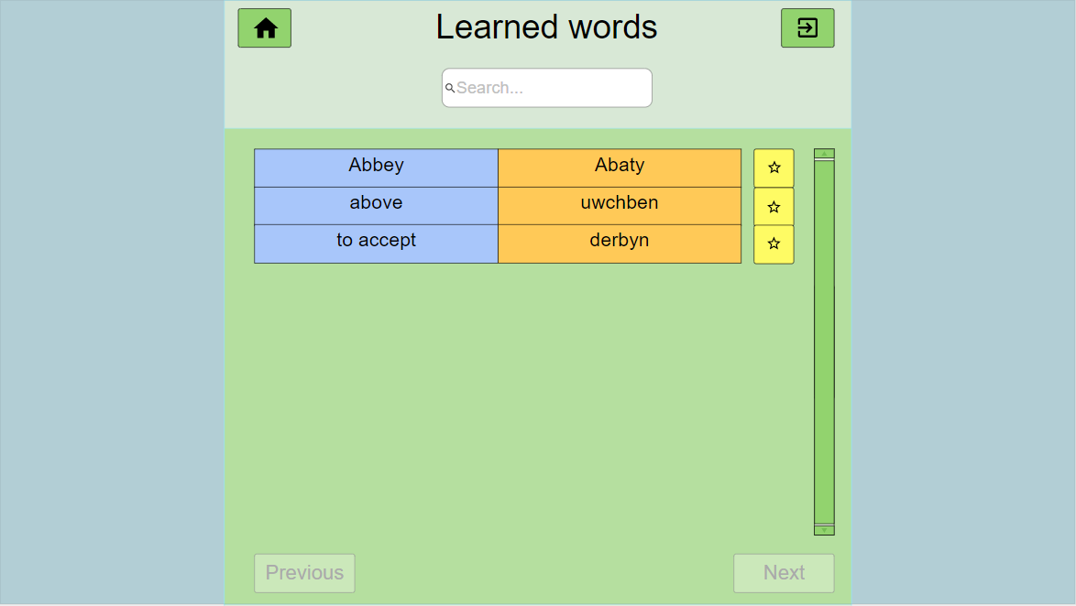
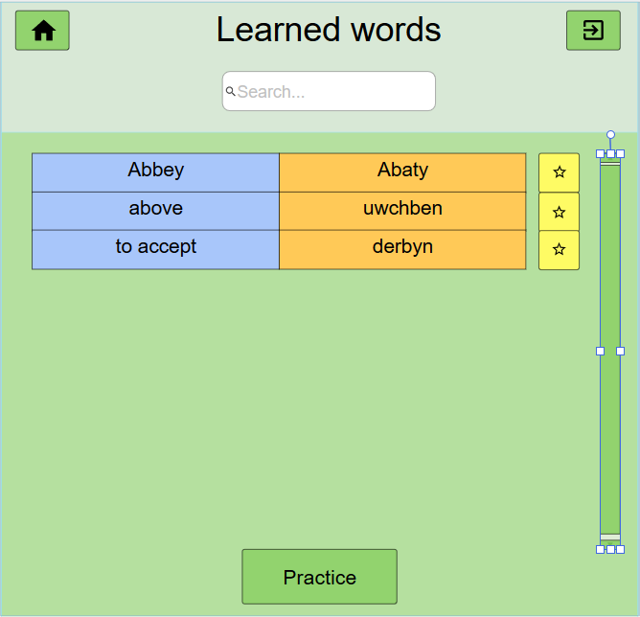
My words
Search bar (when the list is big enough)
List of words
Click to
remove
from list
Scrolling bar
(when list is big)
Go to Practice Words page

Slide 12
Practice Words
Practice Words
Select practice mode
In “my words” section, the practice for those words can be accessed, so the user
Can practice on the words he wants to learn.
Test your skill will start a random series of the 4 practice modes, and display the results at the end
Flashcards
Guess the word
Type the word
Match cards
Test your skill

Slide 13
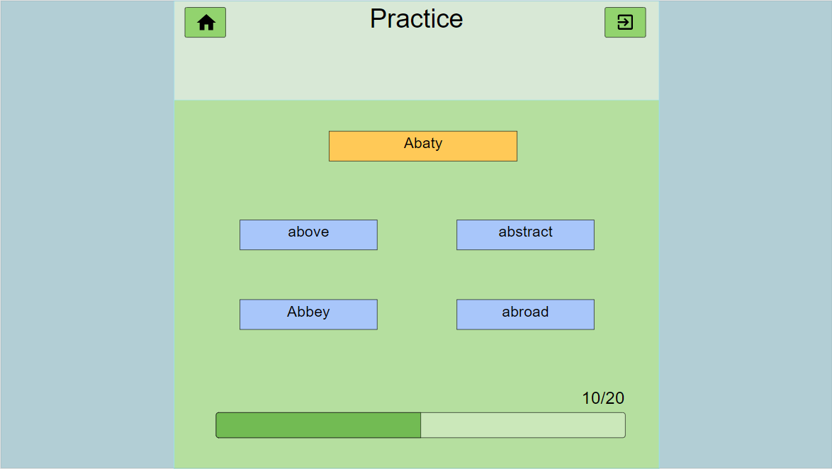

Practice words
Practice mode 1: flashcards
Card in welsh and then in english
Abbey Category - nm
Abaty
Click on this card to show the English translation
Click to remove from “words to learn”
Progress bar

Slide 14
Practice words
Practice mode 2: guess the correct translations of the words
Above
Year
Tomorrow
Abstract
Abbey
Abroad

Slide 15
Practice words
Practice mode 2: guess the correct translations of the words
Word to guess
Possible solutions
Above
Year
Tomorrow
Abstract
Abbey
Abroad
Progress bar

Slide 16
Practice words 2:guess the word
Correct answer case
Wrong answer case
Wrong answer (+0) points
above
Tomorrow
Year
Correct answer (+1) points
Abbey
11/20
Score

Slide 17
Practice words
Practice mode 3: type the correct translation of a word
Word to translate
Above
Type the correct word
uwc____
Skip to next question
(0 points)
skip
Progress bar

Slide 18
Practice words
Practice mode 4: match the words with the correct translation
Step 1: choose the word to match
Step 2: choose the translation
Repeat with all words, after
give points based on score
Different colors can be used
for each pair of words
Above
Above
Abaty
Abbey
Dramor
Abstract
Uwchben
Uwchben
Abroad
Haniaethol
Progress bar

Slide 19

Test mode
At the end of the test, a pop up screen will display the results
Score: 95/100
new test

Slide 20
DOCUMENT HISTORY
Version | CCF No. | Date | Changes made to this document | Changed by
1.0 | N/A | 5/02/2020 | First release | fec11
2.0 | #1 | 20/02/2020 | changed order menu button; just 1 list practice; removed ‘prev’ and ‘next’ buttons; practice in my words list option for practice; remove next and previous + button; shows popup to complete word editor | fec11
2.1 | #2 | 27/02/2020 | Revision after problems found by Christ Price report | fec11
3.0 | #3 | 10/03/2020 | Changed menu words so they fit better together; More explanation linking to use cases; added new flashcard case; added new practice “my words” selection screen; Fixed graphic issues in presentation | fec11
4.0 | #4 | 27/04/2020 | Added 2 words to guess according to the requirements Added “type word” practice mode Added “match words” practice mode Added “test mode” option Added screen explaining “test mode” | fec11

